Slide 1
Project Proposal Fahmida Rahman

Slide 2
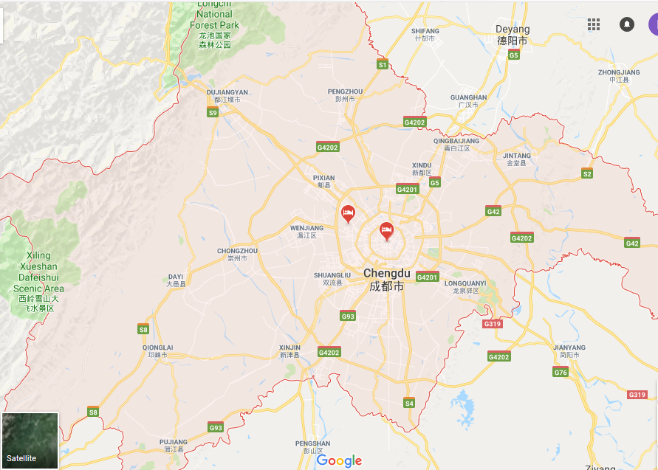
Datasets
Source: DiDi
Location: Chengdu, China
Ride request data
Route Data
Data Accuracy: 3 sec
Data Range: November 1
to November 30, 2016

Slide 3
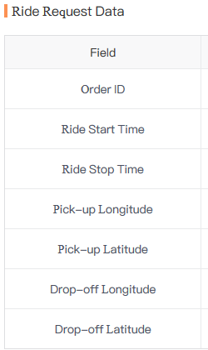
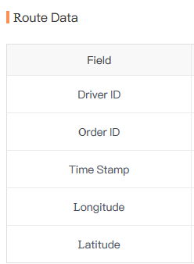
Datasets

Slide 4
Challenges
Preprocessing has to be done before analysis
Large Data
Approximately, 35 million to 50 million Route Data for each day

Slide 5
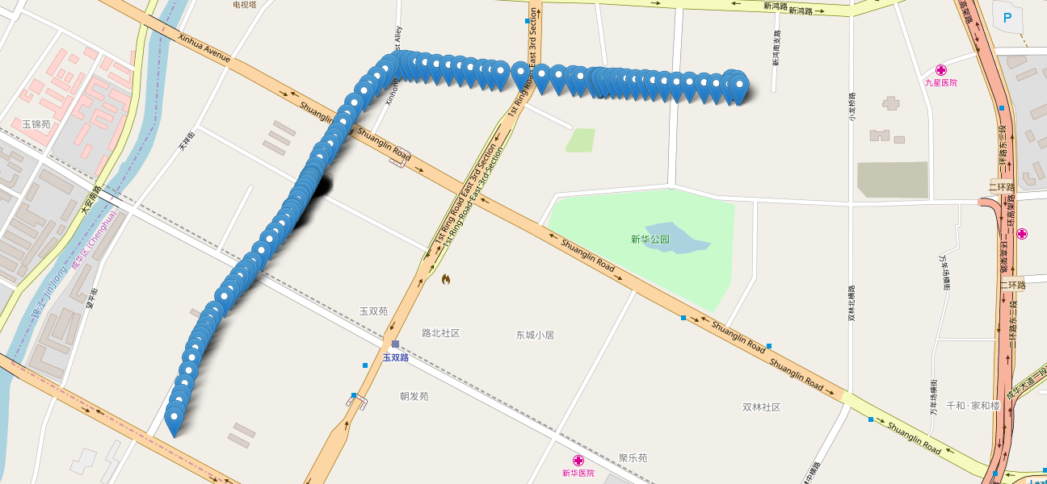
Project Goals and Steps
A major street : Choose
Divide into segments for through analysis
Figure out all the trips come to the corridor
Trip counts in a range of 5 minutes: Instantly it gets into the corridor

Slide 6
Project Goals
To determine the travel time for each trips in the corridor. Aggregation of travel time for each 5 minutes can be done if required.
The process will be done for the 30 days dataset to get the travel time in that corridor.
To observe variability of travel time for Day of Week, Week of Month.
To do some statistical analysis (mean, variance etc.) for speed data in that corridor and compare among those segments.
Finally, variability of speeds in the corridor gives the idea which location is facing maximum speed drop as the dataset gives speed over the trajectory with an accuracy of 3 sec.
Figure out the reason for speed drop ( intersections or bottleneck? )

